Slide 1


Fast Salt System
Progress
Safety analysis, and core, vessel, and plant development
2026 Molten Salt Workshop
October 27–29, 2026
Thomas Wielenga, Ph.D., P.E.
Wielenga Innovation Foundation, Inc.
Notes:
Today I will concentrate on the physical development: the core and vessel, maintenance access, the coolant system and the plant arrangement. We will also include University of Michigan safety-case work.

Slide 2
The Fast Salt System
01
Convert spent fuel
Prepare a crude chloride salt feed.
02
Refine and recycle
Prepare fuel salt and process returned fuel.
03
Produce heat in WISTR
Keep fuel salt and circulating coolant separate.
04
Generate electricity
Transfer heat through three steam-generator loops.
Design targets: 1,500 MW thermal / 600 MW electric
2
Notes:
The project investigates converting spent nuclear fuel into a crude salt feed, refining it into reactor fuel, using that fuel in WISTR, and recycling returned fuel. A separate molten-salt coolant transfers heat to the steam generators and power plant. First I will review work done on safety analysis done at the University of Michigan. Then I will talk about developing the core, reactor building and power plant details

Slide 3
WISTR Safety Analysis
Hangyu Lee and Won Sik Yang
October 28, 2026
Notes:
Extensive safety case analysis was done by post-doc Hangyu Lee in Won Sik Yang’s group at the University of Michigan.

Slide 4
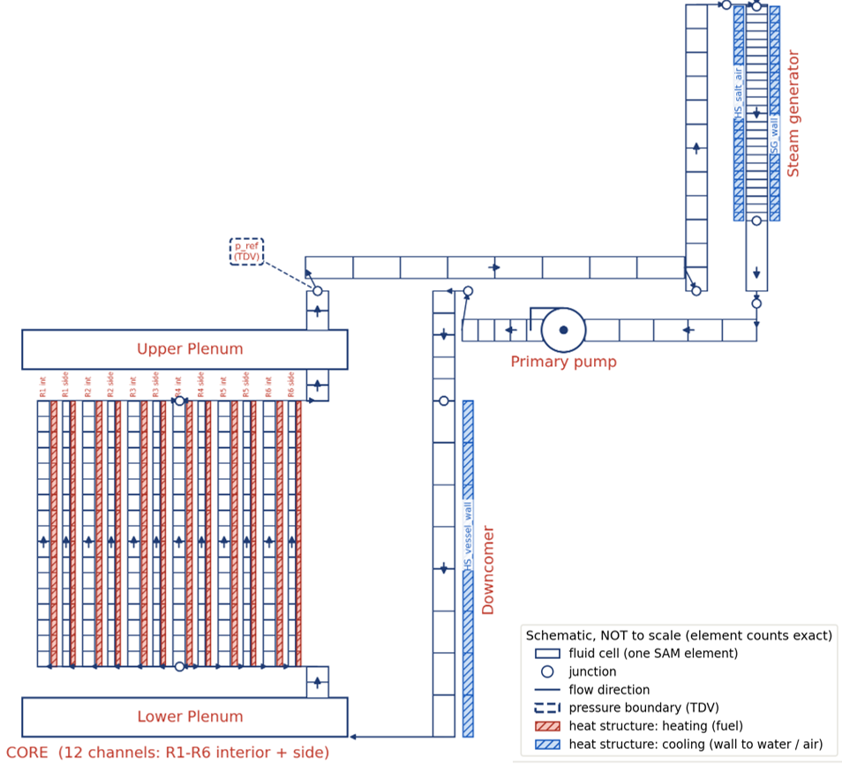
SAM Nodalization Diagram for WISTR Reactor Coolant System
One-dimensional SAM model of the primary circuit
  Six radial regions, each with an interior and a near-wall channel, and fuel salt as the heat structure
  Dual-loop configuration equivalent to three loops so that single-loop failure could be examined
  U-tube supercritical steam generator with air passages (SGACS)
  Air cooling around reactor vessel (RVACS)
  SGACS and RVACS with 30 m natural-draftt air paths
Point kinetics with spatially dependent reactivity feedback (evaluated with PERSENT) and ANS-5.1 decay heat
Shutdown worth of absorber salt injection systems evaluated from OpenMC and the absorber salt injection kinetics
Notes:
The system dynamics was modelled using SAM. The steam generators and reactor vessels have integral air cooling. There were 5 accident scenarios in which the the core was not scrammed: UTOP or Unprotected Transient Over Power in which a weeks worth of fuel was instantaneously injected into the reactor, UPOS or Unprotected Pump Overspeed where the power to the on or all pumps is doubled over 5 seconds, and ULOF or Unprotected Loss of Flow where one or all the pumps are stopped over 5 seconds.

Slide 5
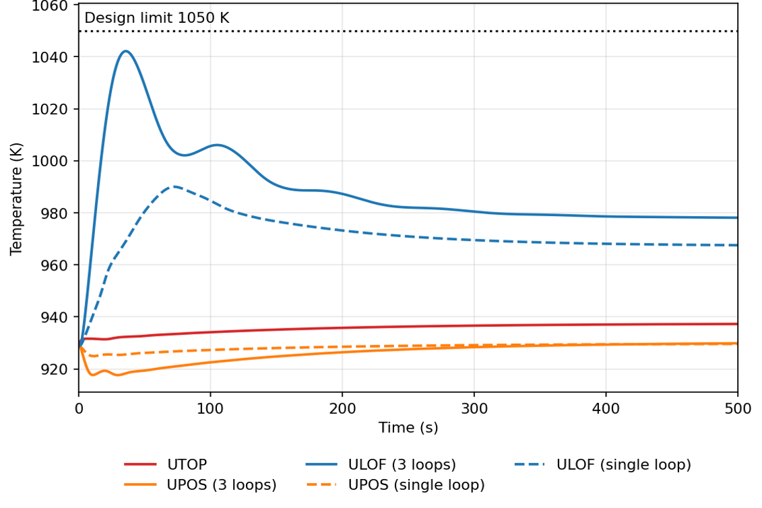
Wall Temperature Evolution in Unprotected Accidents
Notes:
None of the unprotected scenarios resulted in the stainless-steel structure exceeding the design temperature limit. The most stressful scenario was the loss of flow in all three pumps. Even in this scenario, the temperature only briefly approaches its limit. Not shown are the temperatures of fuel and coolant which easily stayed within their limits.

Slide 6
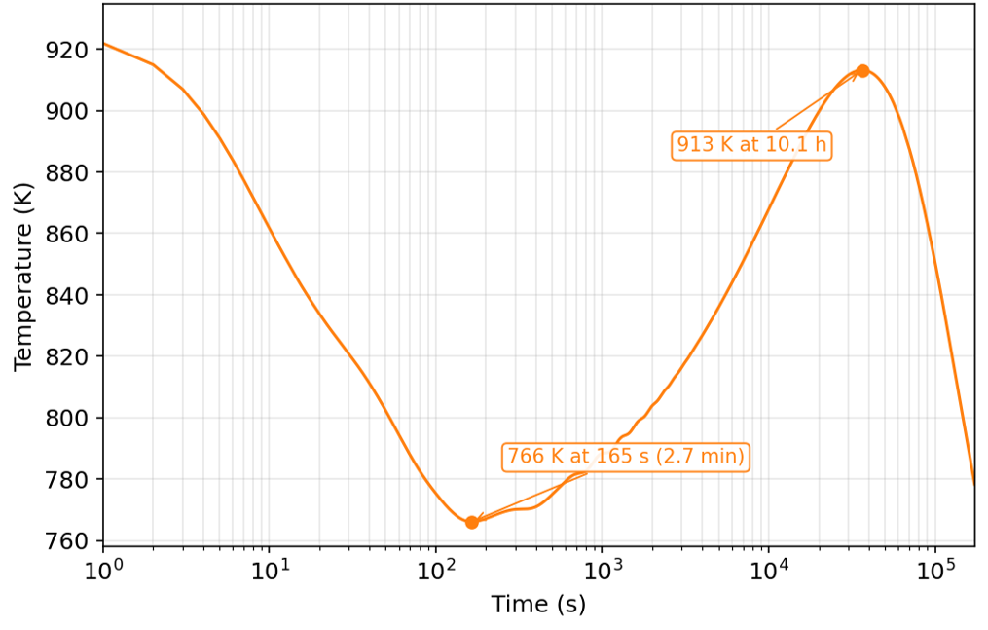
Wall Temperature Evolution in Protected SBO Scenario
Initial decrease due to the reactor shutdown and pump coast down
Then increase due to decay heat until the decay heat removal capacity matches the decay heat
Notes:
This is the result of a station blackout with the reactor scrammed (which is automatic on loss of power). The temperature decreases for nearly three minutes and then gradually increases until decay heat reduces to the heat removal capacity of the steam generator air coolers and the reactor vessel air cooler. The peak is reached after about 10 hours and decreases thereafter. At no point does the fuel or coolant freeze.

Slide 7
Conclusions
WISTR safety features
  Static liquid fuel gives a strong, prompt negative feedback.
  Shutdown and decay heat removal need no electric power (absorber injection systems, SGACS, and RVACS).
Safety analysis study
  SAM safety analysis models of the WISTR primary circuit with spatially dependent thermal feedback and passive heat removal systems were developed.
  Margins to the fuel and structural design limits were quantified.
Demonstrated inherent power self-regulation under various unprotected scenarios
  Strong negative fuel expansion feedback effectively shuts down the reactor.
  Reactor power and temperatures approach stable conditions without SCRAM in the selected UTOP, UPOS, and ULOF scenarios.
Confirmed passive decay heat removal capability
  SGACS and RVACS provide long-term decay heat removal through natural air circulation.
  In the protected SBO scenario, decay heat is removed passively through SGACS.
Notes:
The WISTR demonstrates the ability to withstand transient accident scenarios without a scam. After a scram, passive air cooling can keep the reactor within safe limits even with no station power.

Slide 8

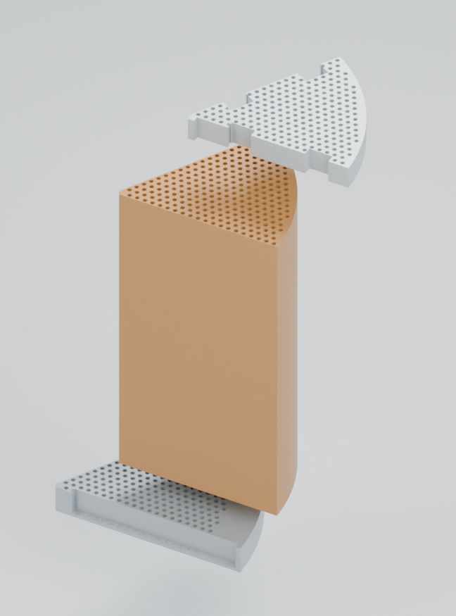
Six removable core sectors
3.8 m core diameter
3.4 m active height
Coolant tubes through fuel tanks
Current geometry concept. Fuel-region partitions remain to model.
3
Notes:
Now to the details. The active core is 3.4 meters high and 3.8 meters in diameter. Coolant flows through tubes within the fuel tanks. There are six sectors and six fuel regions within each sector. The six sectors allow convenient maintenance of the core. Having six regions within them helps minimize the power peak and increases the overall power available.

Slide 9
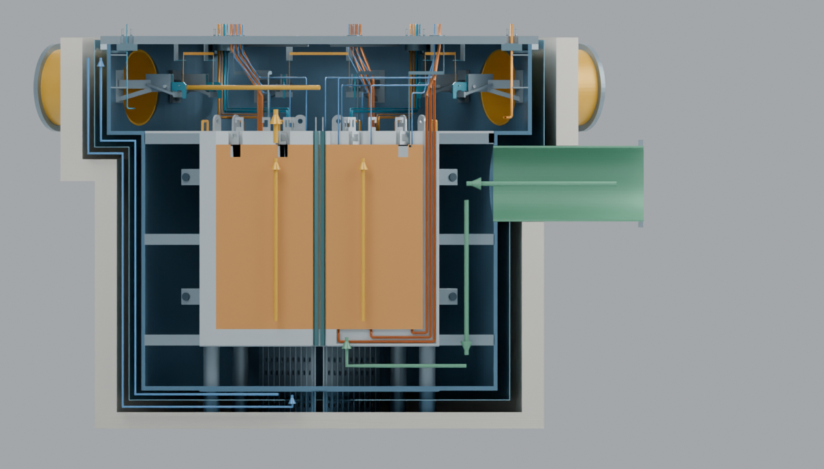
Vessel and coolant path
Side inlet into the downcomer
Inward below the core, then upward through the tubes
Hot plenum supplies three outlet legs
Section view of the coolant and vessel-air paths.
4
Notes:
Coolant enters the side of the vessel below the hot plenum, descends around the core, turns inward through the bottom plenum, and rises through the bottom reflector, coolant tubes and top reflector. The hot plenum distributes flow to the outlet legs. There are three coolant loops. The section also exposes the Reactor Vessel Auxiliary Cooling System with its air path around the vessel.

Slide 10
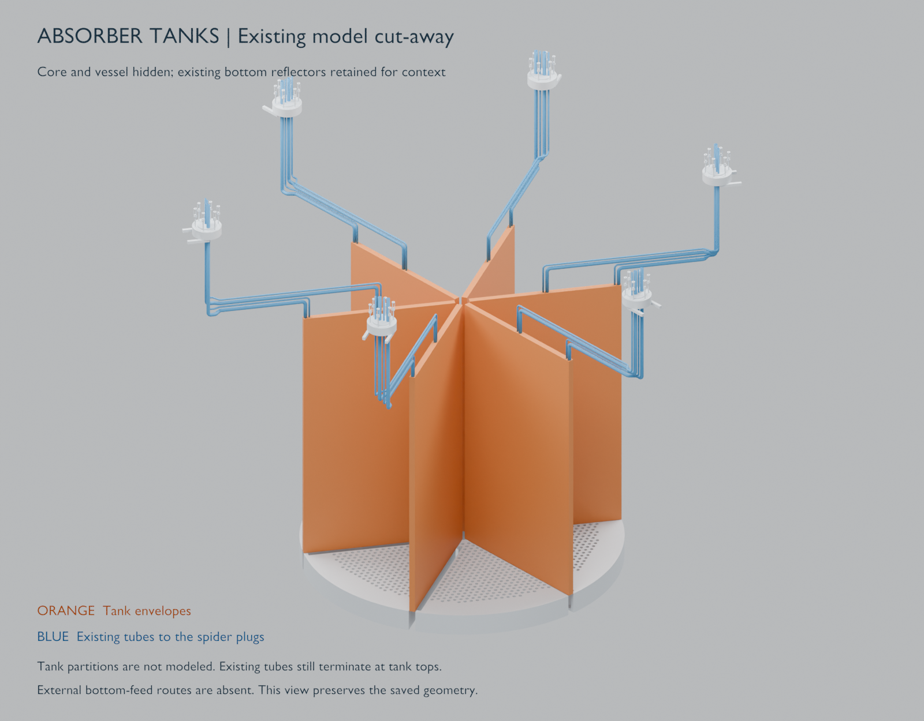
Absorber tanks and service connections
Six radial tank assemblies
Primary and secondary chamber in each assembly
Twelve reservoir and pressure-module circuits
Illustration: chamber partitions and bottom-feed routes remain to model.
5
Notes:
These narrow tanks sit between the core sectors. Each assembly has a primary and secondary chamber, each served by its own external reservoir and pressure module. Orange shows the tank envelopes and blue the service-tubes..

Slide 11
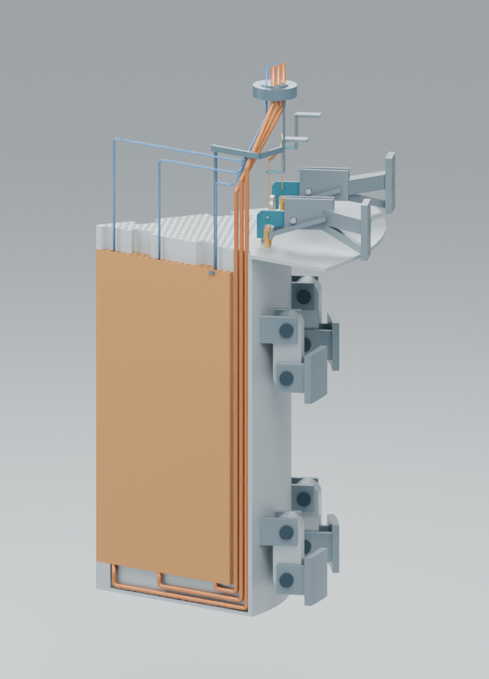
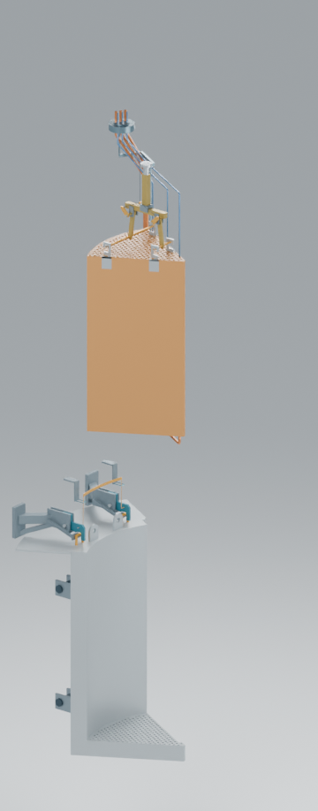
Remote sector maintenance
Raise and latch the sector
Remove the top reflector
Lift the core and its service assembly
Maintenance position
Core removal
Maintenance-position and removal studies. Handling sequence is conceptual.
6
Notes:
The maintenance concept strongly influences the vessel geometry. After shutdown, draining and service disconnection, the insulation and sector cap are removed using the crane and a specially designed tool. The crane raises the sector, and the four-bar linkage moves it toward the vessel wall, where latches hold it in the maintenance position. The top reflector and core can then be lifted separately. The left image shows the raised assembly and the right shows core removal. The hook arrangements on the insulated cap, top reflector, and core sector permit the use of a common lifting tooling that can be engaged and disengaged remotely.

Slide 12
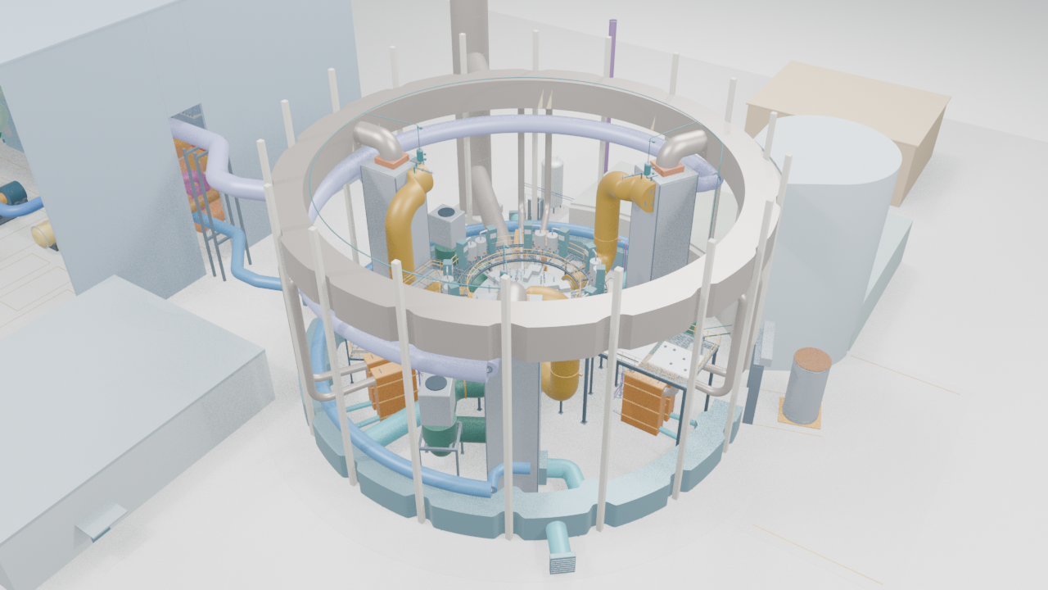
Reactor building and three coolant loops
One pump and steam generator per loop
Coolant storage and preparation beside the building
Air headers, service lines and maintenance access
Draft equipment arrangement. Casing envelopes and active lengths are distinct.
7
Notes:
There are three steam generators and cold-leg pumps with large insulated salt pipes. The salt pipes are approximately 1.4 m in diameter. The coolant tank may need to store the entire inventory of coolant salt during maintenance and is in an attached enclosure near the coolant preparation area. The model also provides room for fuel maintenance tanks, absorber service modules, the catwalk and temporary laydown during maintenance. Hot and cold air ducts serve the vessel and other equipment. The steam-generator casing remains a provisional 17-meter visual envelope, distinct from the approximately 11.92-meter active length in the recent hydraulic workbook.
Here is how those components fit inside the reactor building: the reactor and maintenance walkway in the center, surrounded by three steam generators, pumps, and the fuel-handling equipment.

Slide 13
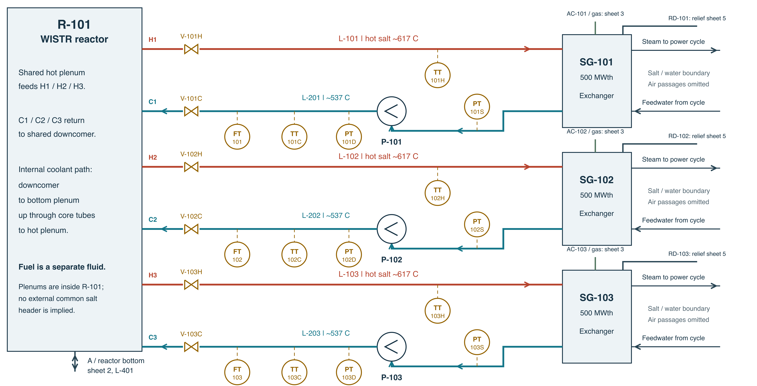
Coolant system: from 3D layout to P&ID
FS-CS-001 / Coolant circulation / 15 October 2026 snapshot
8
Notes:
Here is the same coolant system in a different view. The 3D model shows where the reactor, steam generators and pumps fit. The P&ID records their connections, valves and instruments. Follow one hot line from the reactor to a steam generator, then the return through its pump. The other two loops repeat that arrangement. We use common equipment identifiers to connect these views.

Slide 14
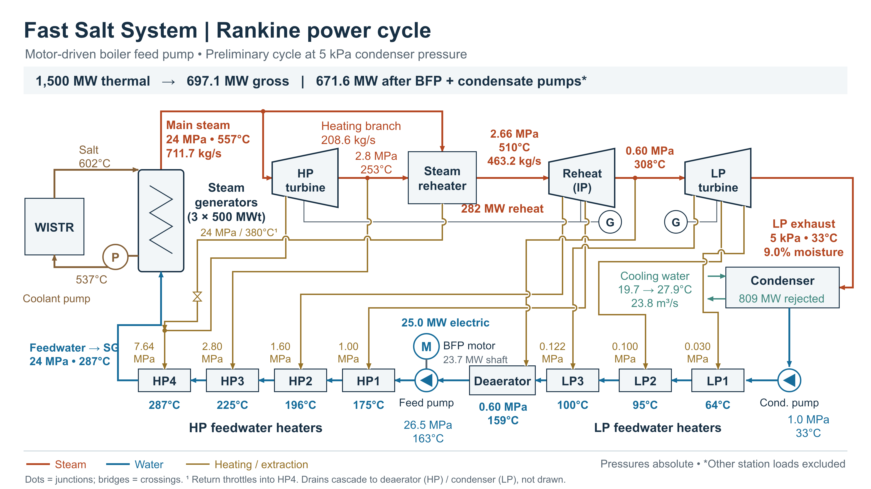
Preliminary Rankine cycle
Motor-driven BFP case, 11 October 2026 calculation revision.
9
Notes:
The preliminary power conversion is a steam cycle with steam reheat between high pressure turbine and intermediate turbine. It uses a portion of the steam from the steam generators for reheat. It uses feedwater heaters to raise the input temperature to the steam generators to minimize the likelihood of freezing salt and raise overall efficiency The high-pressure boiler feed pump is motor-driven, requires significant power, and raises the pressure to supercritical pressure of 24 MPa. The estimated power output is around 670 MW for an efficiency of 44.7%.

Slide 15
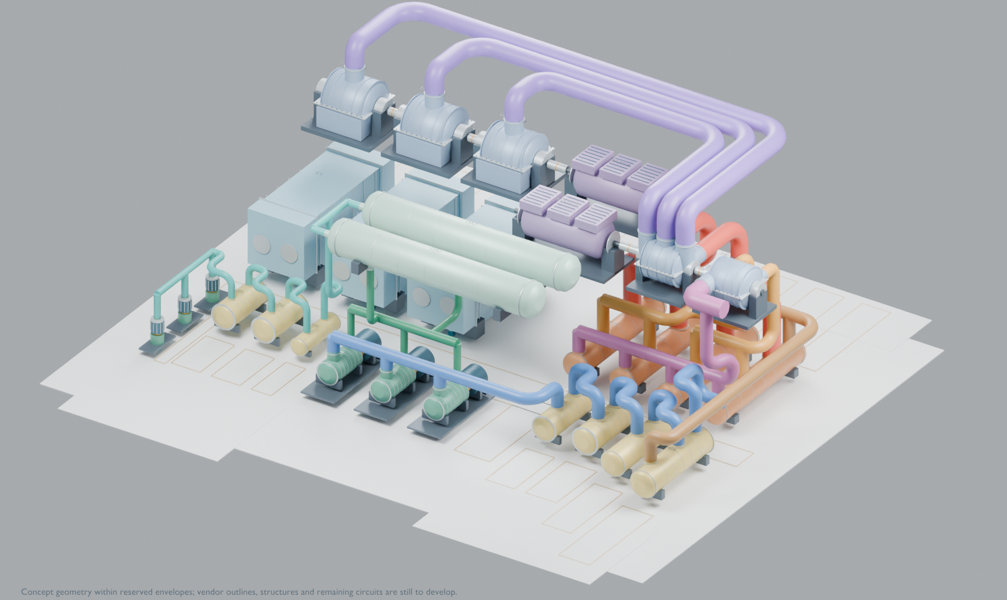
Steam power plant
HP/IP and LP turbine trains
Reheat, condensers and feedwater heating
Motor-driven boiler feed pumps
Preliminary cycle and layout. Equipment exteriors are illustrative.
10
Notes:
The power-plant model now includes turbine casings, generators, condensers, reheaters, feedwater equipment and the principal piping paths. The selected draft uses motor-driven boiler feed pumps. Equipment exteriors are illustrative, and the cycle calculation is preliminary.

Slide 16
Working with an Electronic Intelligence (ChatGPT/CODEX)
01
I specify the engineering intent
Dimensions, constraints, interfaces, initial analysis and questions to answer.
02
The EI prepares working files
Recommends designs, geometry, detailed calculations, documentation and views.
03
We inspect and revise
Check units, assumptions, connections and visible clearances.
04
We preserve the reviewed state
Sources, decisions and changes remain in Git history.
16
Notes:
This as an iterative working process. I give the EI initial calculations, concrete requirements or goals. It edits source files and produces a model view or readable calculation. I inspect it, correct the assumptions and ask for more revision. The useful output is the working material that we can inspect and rerun. Git commits and pull requests let collaborators see exactly what changed. This is highly productive. What would take an engineering team weeks, can be accomplished in minutes. It is really astounding. The 3D design that you are seeing took a matter of about 2 weeks to accomplish by a single individual and CODEX (ChaGPT-6 Astra).

Slide 17
Tools and the files they produce
Tool | Role in this project
Markdown | Design notes, assumptions, decisions and study reports
Hurmet | Readable calculations with units and editable inputs
Python | Geometry generation and calculation automation
Visual Studio Code | Edit code and Markdown, preview files and review changes
Blender | Rotate, inspect, cut away and render the 3D models
GitHub | Share sources, review changes and preserve versions
Selected identities and connections are shared through TOML.
17
Notes:
The tools used are all open source, free to use, and ease EI and human collaboration. Markdown is easy to write, is presentable, and easy to compare between revisions. Hurmet makes calculations easy, while showing the equations and results in Markdown files.. Python generates repeated geometry and supports calculation checks. . Visual Studio code is programmer tool used for examining changes in the code and markdown files. Blender is the interactive inspection and rendering environment. GitHub makes the sources and review history available to the team. TOML is a specification language that can be used as a common resource for different tools.

Slide 18
There is much to do
Match analysis and geometry
Track the dimensions, material regions and revision used for each result.
Resolve equipment interfaces
Steam-generator details, heat removal, services and remote handling.
Review and contribute
Use the public repositories to share issues and proposed changes.
U of M NERS: neutronics and safety studies MSU: steam-generator student project
18
Notes:
The University of Michigan NERS team work on the neutronics and safety-cases and Michigan State University students are working on the steam-generator project. Anyone can review the work done and make comments.

Slide 19


Explore the project
fastSalt
fastSaltModels
Design records, calculations and studies
Python, Blender and model results
github.com/FastSaltSystem/fastSalt
github.com/FastSaltSystem/fastSaltModels
19
Notes:
The fastSalt repository contains design records, calculations and studies. fastSaltModels contains the Python and Blender sources and preserved model results. Both repositories are publicly readable. Start at the README and results pages first. Changes can be proposed and reviewed through GitHub.

Slide 20
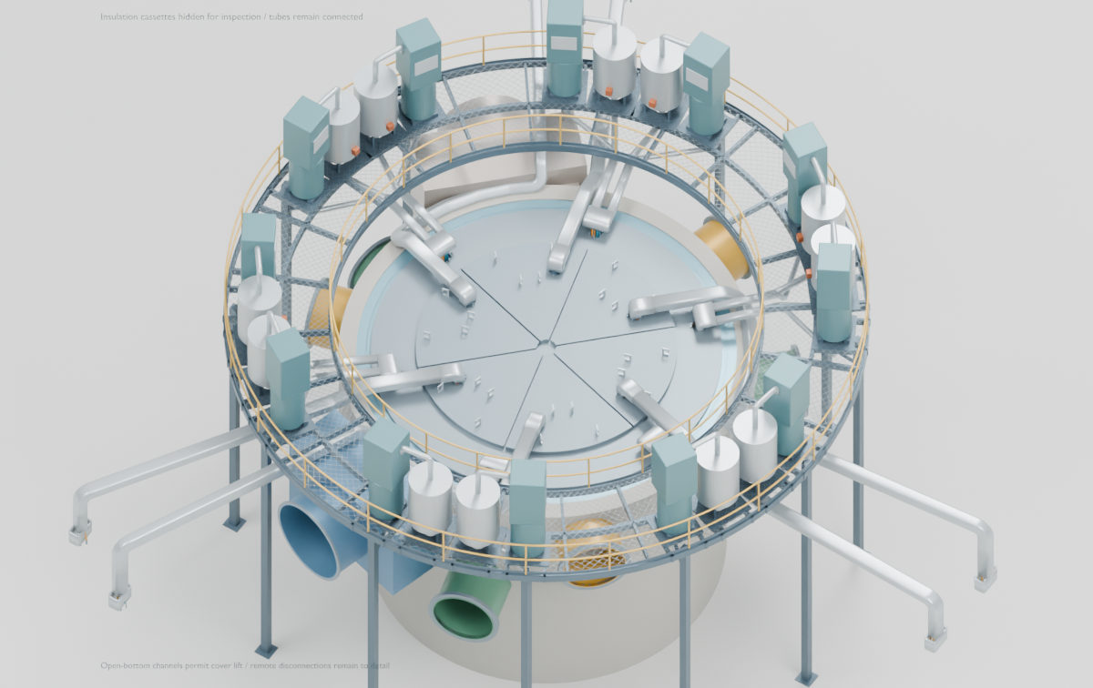
Backup: services below the insulation
Absorber modules around the catwalk
Fuel-service bundles above the caps
Removable plugs at service penetrations
Backup. Preserved 12 October routing view, insulation hidden.
21

Slide 21
Summary of Analyzed Accident Scenarios
Accident class |  | Station Blackout (SBO) | Reactivity induced | Flow rate induced
Accident |  | Protected SBO | UTOP | UPOS | ULOF | UPOS, single | ULOF, single
Initiating events |  | Loss of all on-site power w. scram | Fresh fuel charge | Pump power doubled, all loops | Pump power lost, all loops | Pump power doubled, single loop | Pump power lost, single loop
Transient variable |  | Pump head to zero, feedwater to zero, -6,700 pcm in 20 s | Step reactivity of 50 pcm | Pump head +56% (5 s) | Pump head to zero (5 s) | Single pump head +56% (5 s) | Single pump head to zero (5 s)
Peak Temperature (K) | Fuel * | 915 | 1,151 | 1,148 | 1,163 | 1,145 | 1,160
 | Coolant** | 914 | 897 | 894 | 1,005 | 892 | 950
 | Wall*** | 913 | 936 | 930 | 1,042 | 928 | 988
Peak power (%) |  | – | 118.4 | 104.4 | – (no rise) | 101.6 | – (no rise)
Asymptotic power (%) |  | – | 101.3 | 102.2 | 68.3 | 100.7 | 86.6
*Fuel boiling point: 1,837 K; design limit of fuel temperature: 1600 K
**Coolant boiling point: 1,383 K; design limit of coolant temperature: 1200 K
***SS316 service limit (ASME Sec. III, Div. 5): 1,089K; design limit of structure temperature: 1050 K

Slide 22
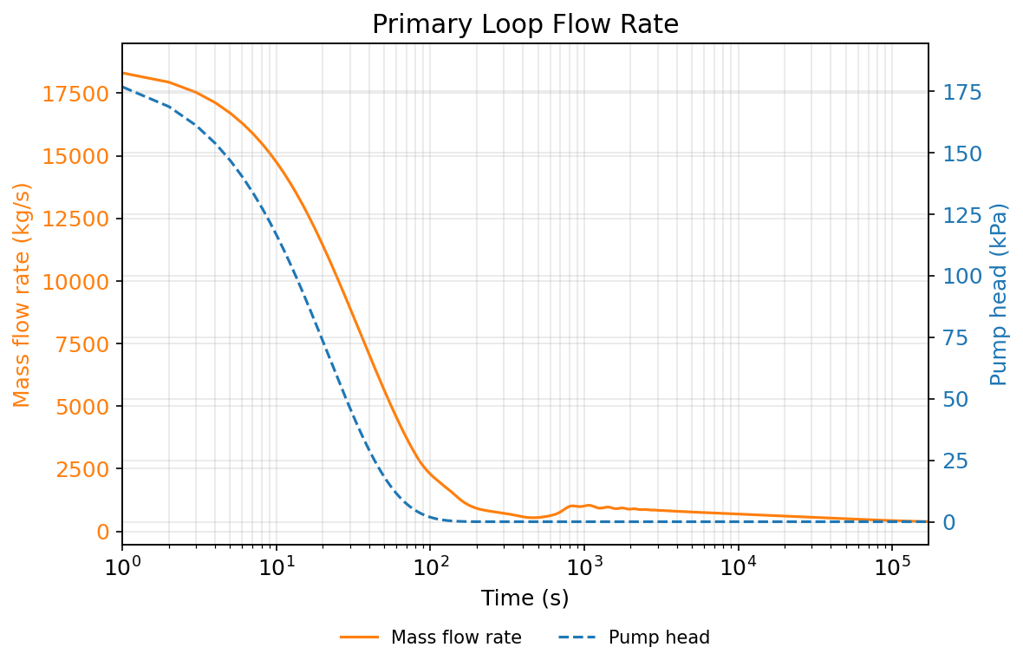
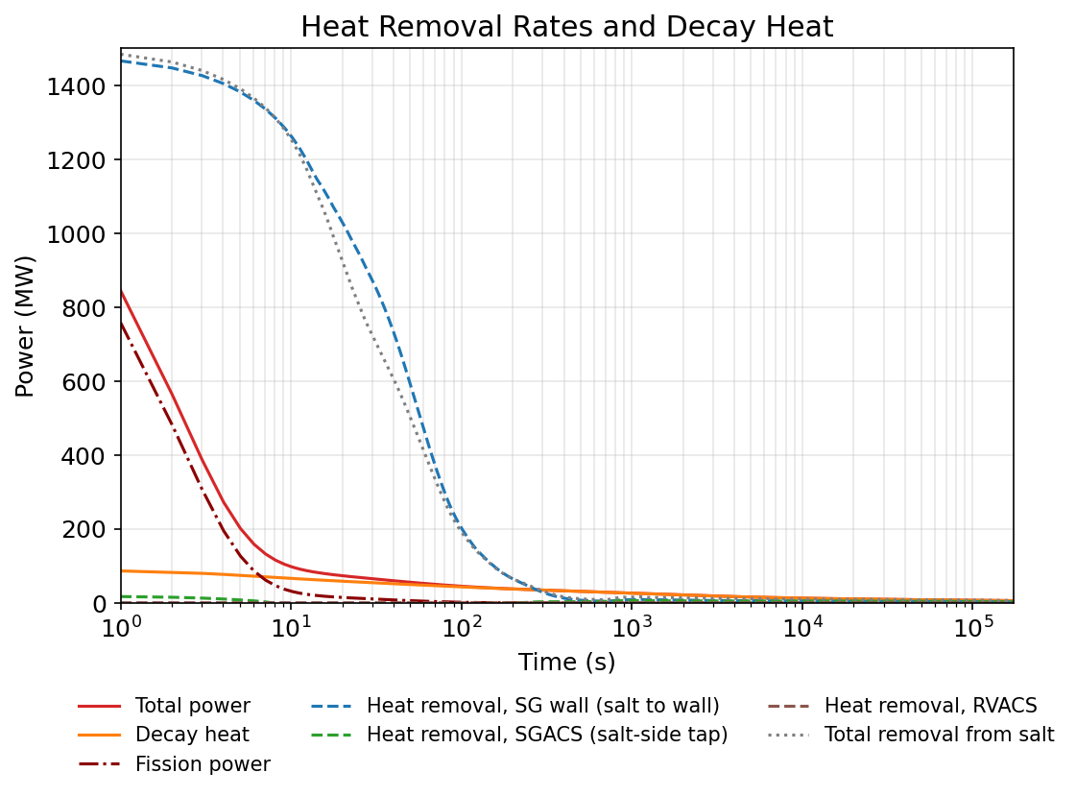
Natural Circulation and Heat Balance in Protected SBO Scenario
200–1,000 s: Net heat accumulation begins at ~200 s and triggers delayed flow recovery after ~400 s.
After 1,000 s: Declining decay heat gradually reduces natural circulation flow.

